Slide 1


PON & C++
Can it go faster?!
Schutz,Fernando
Tópicos Avançados Em Engenharia De Software 1
FABRO, João A. && Simão, Jean M.

Slide 2

Summary
Ideas
Development
Tests/Results
Conclusion

Slide 3

Ideas
Inline methods/functions
  Are intended to make it more efficient, for the speed, the code that calls these functions.
  Are treated by the compiler as almost a macro definition.
  The function call is replaced by the body function.
  Extremely efficient for small functions, as it prevents code generation for the call and the return of function.
Static
  There is a single piece of storage for a static data member, regardless of how many objects of that class you create.
  All objects share the same static storage space for that data member, so it is a way for them to “communicate” with each other.
  Global
Each NOP entity is a class (much more archives!!!)

Slide 4
Ideas
Attribute
Premise
Subcondition
Method
setValue()
notify()
inc()
dec()
run()

Slide 5

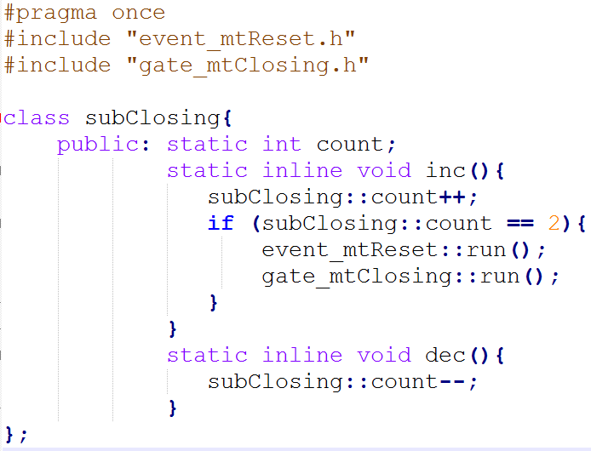
Development
createAllRules(mapRules);
createAllPremises(mapPremises);
createAllInstigations (mapInstigations);
createAllInstantiations (mapInstantiations);
Iterate Rules
Rules->Conditions
Rules->Instigations (#includes)
Create “subconditions.h”

Slide 6
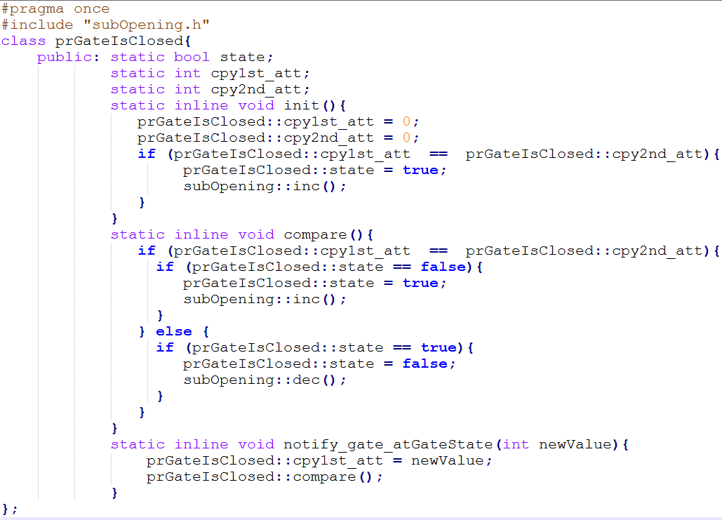
Development
createAllRules(mapRules);
createAllPremises(mapPremises);
createAllInstigations (mapInstigations);
createAllInstantiations (mapInstantiations);
Iterate Premises
Rules->Conditions (#includes)
Create “premises.h”

Slide 8
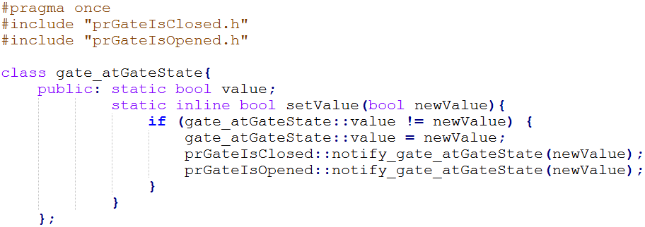
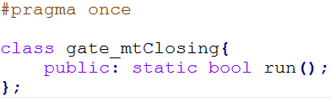
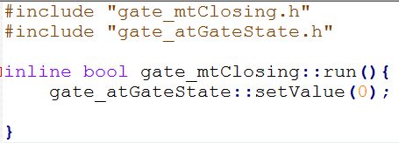
Development
createAllRules(mapRules);
createAllPremises(mapPremises);
createAllInstigations (mapInstigations);
createAllInstantiations (mapInstantiations);
Iterate Instantiations
Instantiations->fbe->Methods
Create “methods.h” && “methods.cpp”
Instantiations->fbe->Attributes
.->Attributes->Premises (#includes)
Create “attributes.h”

Slide 10
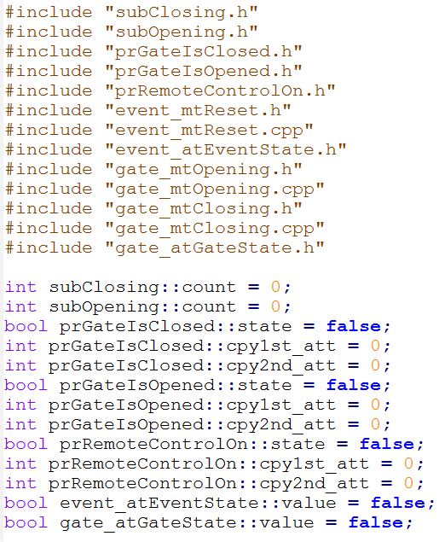
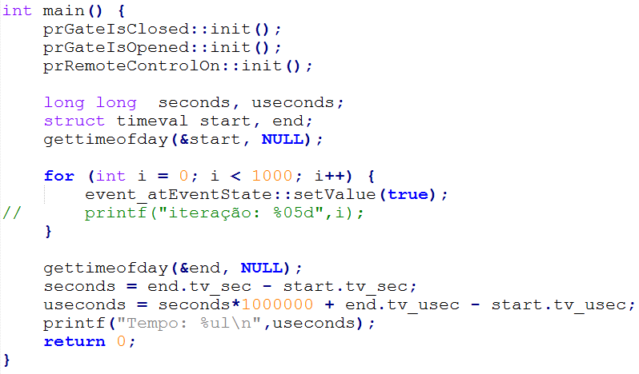
Main.cpp

Slide 11

Results

Slide 12

Conclusions
Faster!
Questions to review/debate/do something
  Inicialization problem in C version
  Names of functions in C
    funcInsteventPrprRemoteControlOnNotifyScsubOpening();
    prRemoteControlOn::notify_event_atEventState(newValue);
  Problem with instantiations (attributes) in compiler
  Define a default type of programming inside the methods
Personal and Professional growing by the class experience!

